Slide 1

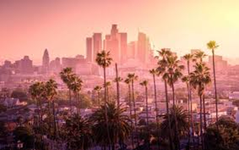
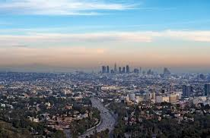
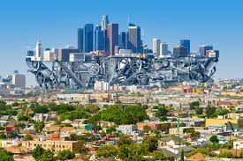
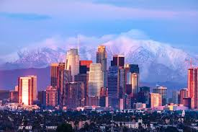
Explore the wonders of Los Angeles
Your ultimate guide

Slide 2
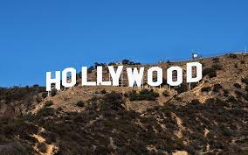
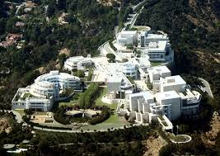
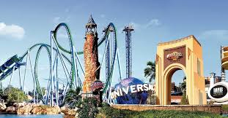
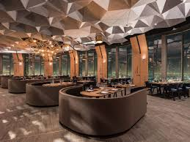
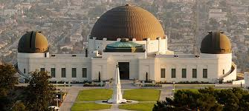
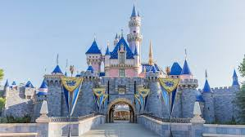
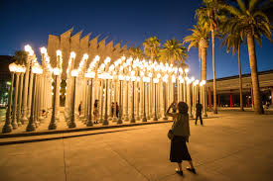
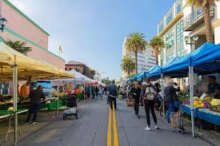
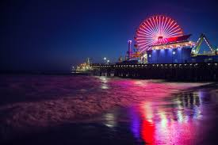
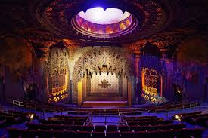
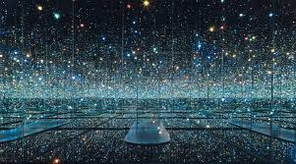
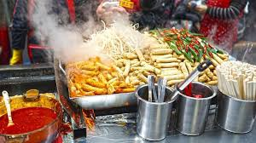
Discover iconic landmarks
Explore cultural hotspots
Experience Thrills and entertainment
Indulge in
culinary delights
`u
`
`
`
Universal Studios Hollywood: Enjoy movie-themed rides and behind-the-scenes tours.
Hollywood Sign:
Capture the iconic view and hike the trails for a close-up.
Getty Center:
Admire world-class art and stunning architecture.
Downtown LA Restaurants: Dine at acclaimed eateries offering a variety of cuisines.
`
`
`
Griffith Observatory:
Enjoy panoramic views of the city and stargazing opportunities.
Disneyland Resort:
Experience the magic of Disneyland and California Adventure.
Los Angeles County Museum of Art (LACMA):
Explore diverse art collections and installations.
Farmer's Markets:
Taste fresh produce and artisanal goods at markets like The Original Farmers Market.
`
`
`
Santa Monica Pier:
Experience the classic amusement park and stunning sunset views.
Live Music and Theater:
Catch performances at venues like the Hollywood Bowl and Pantages Theatre.
The Broad:
Discover contemporary art in a cutting-edge space.
Street Food:
Taste the flavors of LA at iconic spots like the Grand Central Market.

